Slide 1



Exploratory Analysis Austin Animal Center Shelter
By Leo Barbosa
https://github.com/Leo8216/Exploratory-Analysis-Austin-Animal-Center-Shelter
Notes:
Exploratory analysis of Austin Animal Center Shelter dataset using python 3.6. The Austin Animal Center is the largest no-kill animal shelter in the United States that provides care and shelter to over 18,000 animals each year. The time frame for all visualizations is from 2013 Q4 to 2018 Q1.

Slide 2

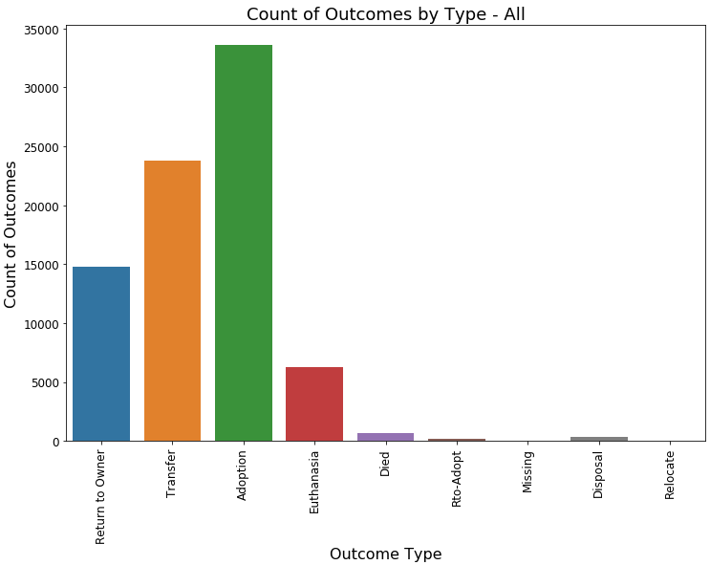

Slide 3
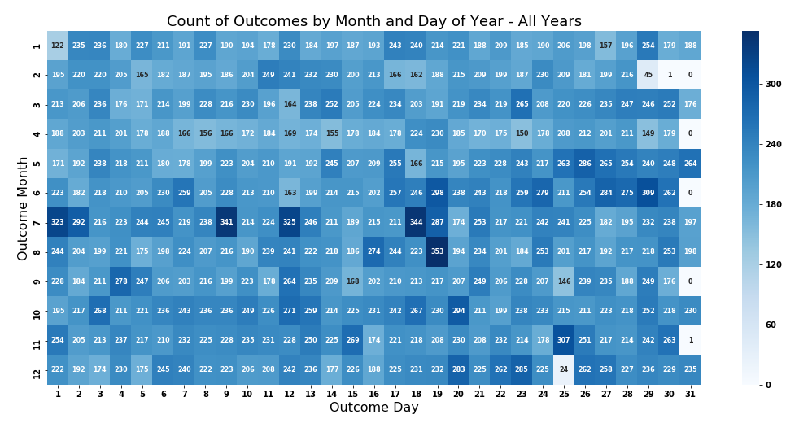
Notes:
Leap year 2016

Slide 4
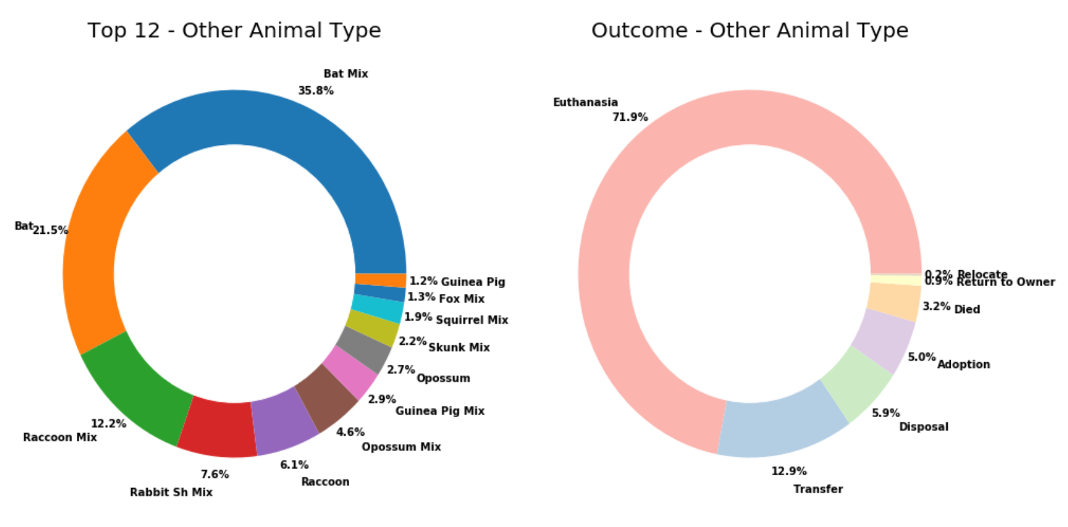
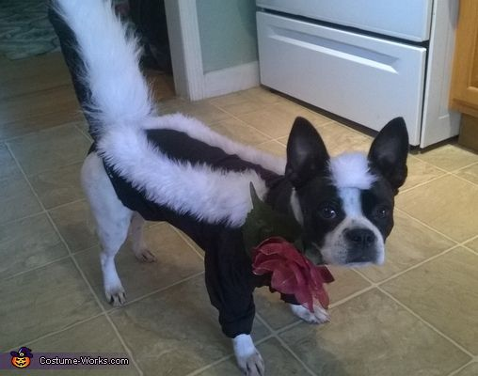


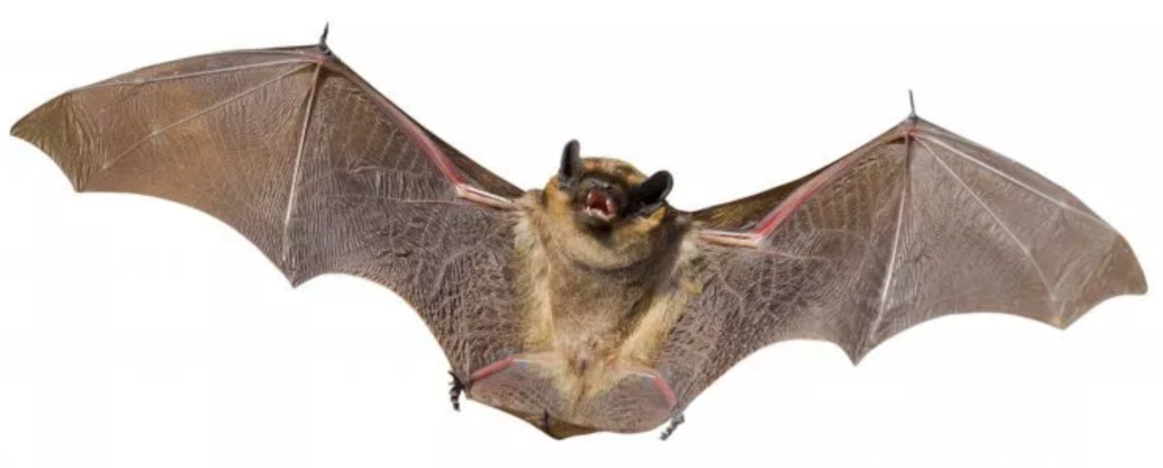

Slide 5

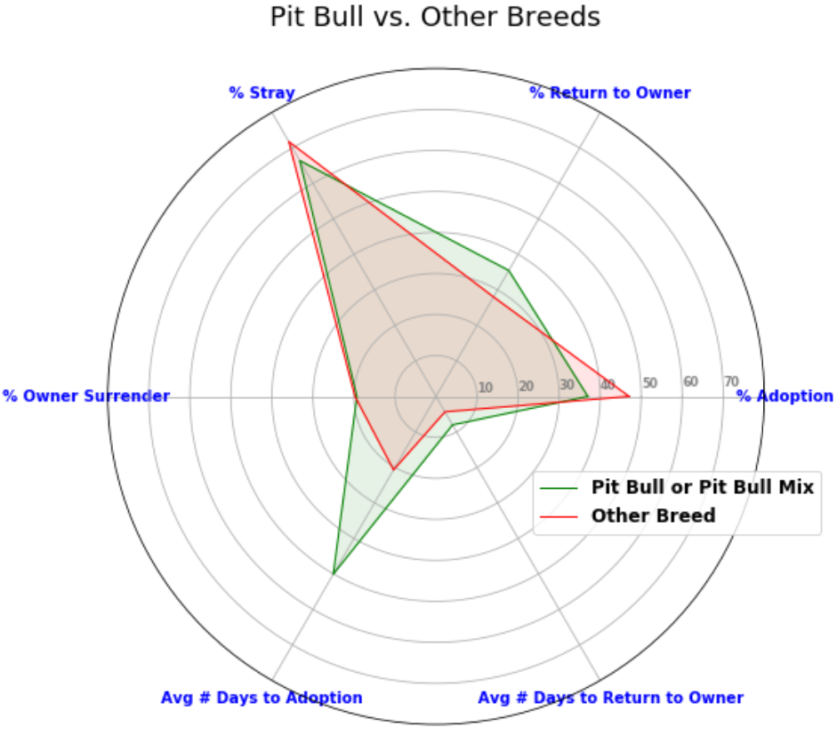
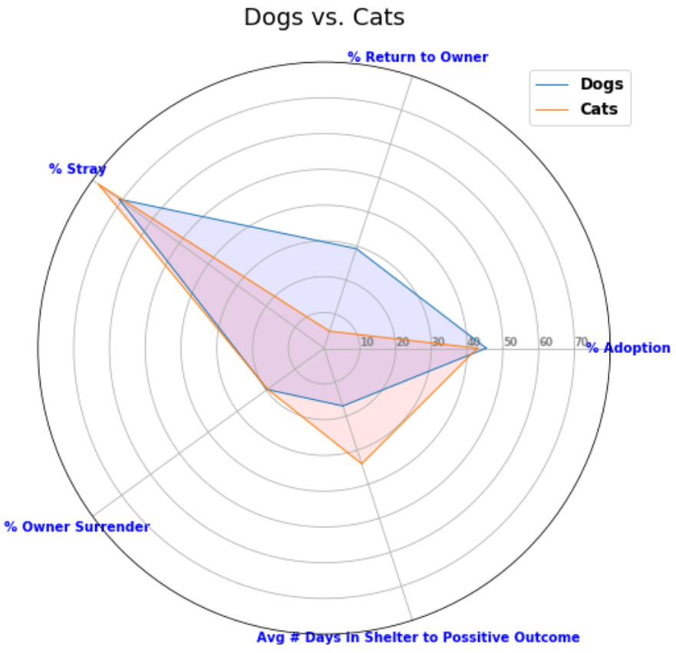

Dogs preferred
over Cats
Other Breeds preferred over Pit Bulls

Slide 6
Questions?
For facts and reliable information about Pit Bull type dogs, refer to https://www.pitbullinfo.org/.

